Slide 1
Introduction Chapter 1
Uses of Computer Networks
Network Hardware
Network Software
Reference Models
Example Networks
Network Standardization
Metric Units
Revised: August 2011
Notes:
Gray units can be optionally omitted without causing later gaps

Slide 2
Uses of Computer Networks
Computer networks are collections of autonomous computers, e.g., the Internet
They have many uses:
Business Applications »
Home Applications »
Mobile Users »
These uses raise:
Social Issues »
This text covers networks for all of these uses
Notes:
Contrast computer networks with distributed systems, in which a model on top of the network is used to present the independent computers to users as a single coherent system, e.g., the Web.

Slide 3
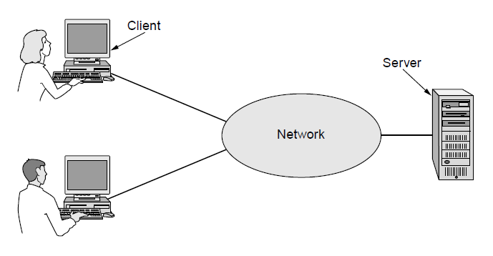
Business Applications
Companies use networks and computers for resource sharing with the client-server model:
Other popular uses are communication, e.g., email, VoIP, and e-commerce
request
response
Notes:
Resource sharing was initially about physical resources, such as printers, but is now often about access to information, such as a file server.
The Web is an example of client-server computing.

Slide 4
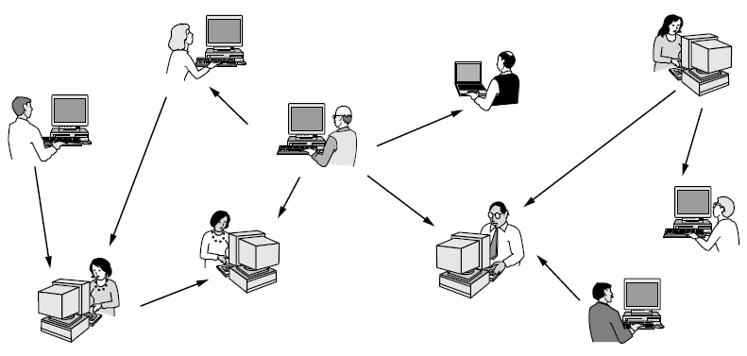
Home Applications
Homes contain many networked devices, e.g., computers, TVs, connected to the Internet by cable, DSL, wireless, etc.
Home users communicate, e.g., social networks, consume content, e.g., video, and transact, e.g., auctions
Some application use the peer-to-peer model in which there are no fixed clients and servers:
Notes:
P2P contrasts with client-server. Why is it under home applications? Because unlike cloud there is no need to have a business run dedicated infrastructure for the app to work.

Slide 5
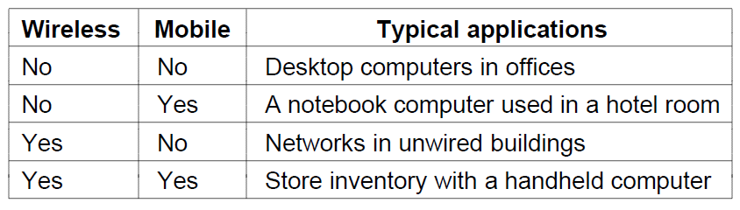
Mobile Users
Tablets, laptops, and smart phones are popular devices; WiFi hotspots and 3G cellular provide wireless connectivity.
Mobile users communicate, e.g., voice and texts, consume content, e.g., video and Web, and use sensors, e.g., GPS.
Wireless and mobile are related but different:
Notes:
Laptop sales outpaced desktop sales in 2010, and there are many more mobile phones (but not smart phones) than personal computers.

Slide 6
Social Issues
Network neutrality – no network restrictions
Content ownership, e.g., DMCA takedowns
Anonymity and censorship
Privacy, e.g., Web tracking and profiling
Theft, e.g., botnets and phishing
Notes:
In the US, DMCA (Digital Millennium Copyright Act) takedowns are automated notices sent by content owners to parties they believe are inappropriately putting copyrighted content online. They instruct the party to take down the content or face legal measures.

Slide 7
Network Hardware
Networks can be classified by their scale:
Scale | Type
Vicinity | PAN (Personal Area Network) »
Building | LAN (Local Area Network) »
City | MAN (Metropolitan Area Network) »
Country | WAN (Wide Area Network) »
Planet | The Internet (network of all networks)
Notes:
An “internetwork” is any larger network made up of smaller component networks. The “Internet” (with a capital I) is the set of all connected networks.

Slide 8
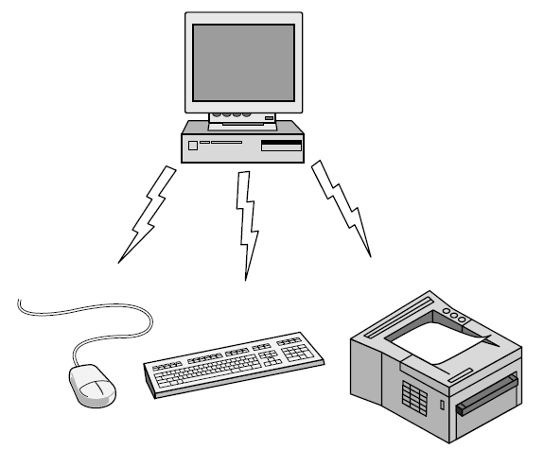
Personal Area Network
Connect devices over the range of a person
Example of a Bluetooth (wireless) PAN:

Slide 9
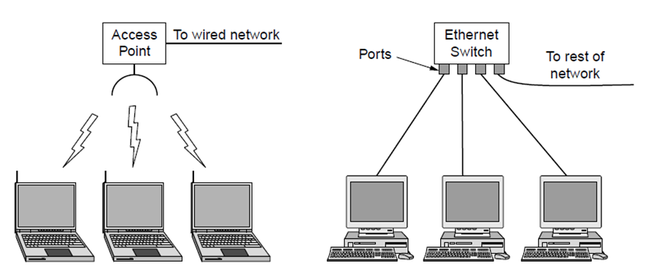
Local Area Networks
Connect devices in a home or office building
Called enterprise network in a company
Wireless LAN
with 802.11
Wired LAN with
switched Ethernet

Slide 10
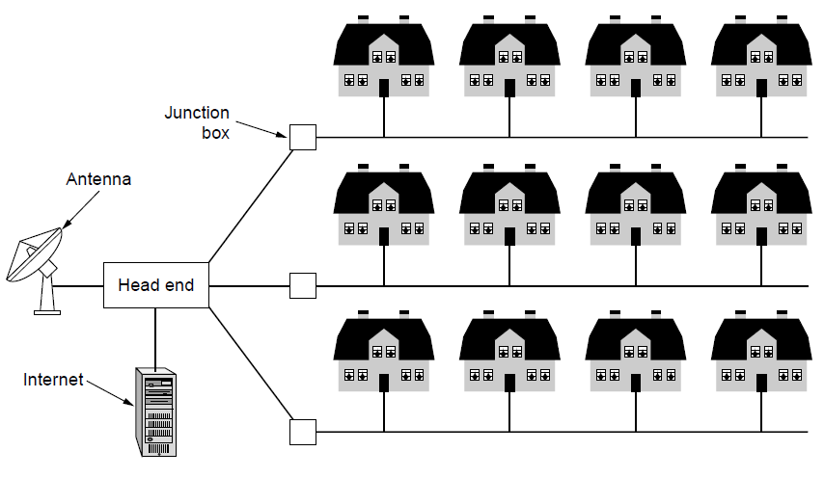
Metropolitan Area Networks
Connect devices over a metropolitan area
Example MAN based on cable TV:
Notes:
This is a common way in which home subscribers obtain access to the Internet in the US.

Slide 11
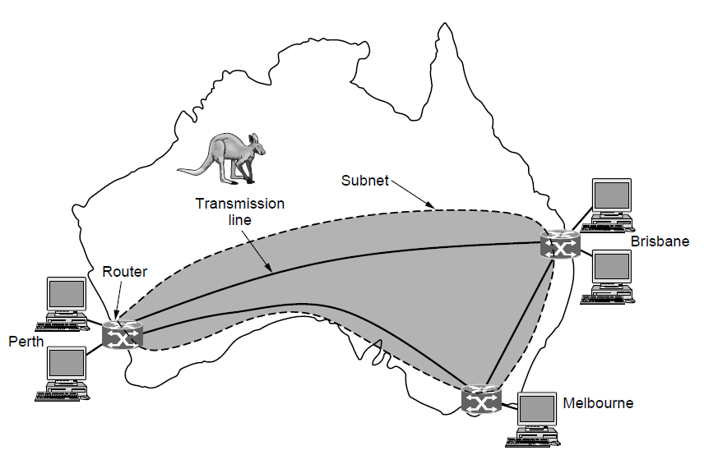
Wide Area Networks (1)
Connect devices over a country
Example WAN connecting three branch offices:
Notes:
The company probably leases the transmission lines (since most companies do not have their own lines).

Slide 12
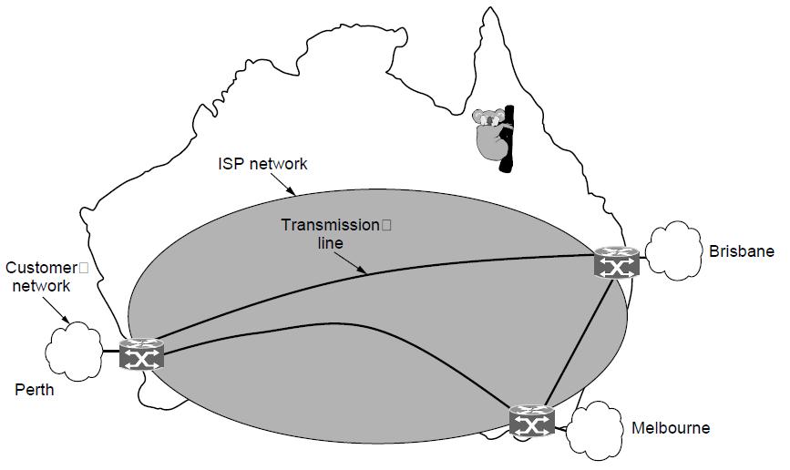
Wide Area Networks (2)
An ISP (Internet Service Provider) network is also a WAN.
Customers buy connectivity from the ISP to use it.
Notes:
Now the company/customer buys service from an ISP who uses its own lines to deliver packets.

Slide 13
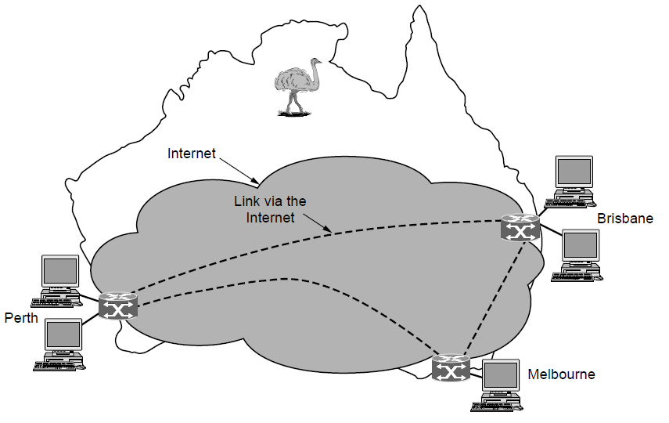
Wide Area Networks (3)
A VPN (Virtual Private Network) is a WAN built from virtual links that run on top of the Internet.
Notes:
Now the company/customer uses the Internet (might be multiple ISPs) for connectivity. The links are virtual in the sense that they refer to some path via the Internet rather than a particular transmission line.

Slide 14
Network Software
Protocol layers »
Design issues for the layers »
Connection-oriented vs. connectionless service »
Service primitives »
Relationship of services to protocols »

Slide 15
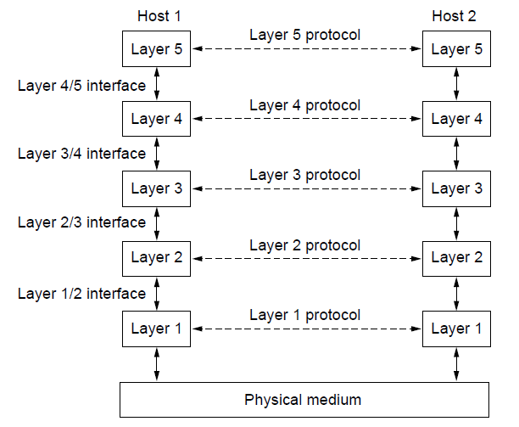
Protocol Layers (1)
Protocol layering is the main structuring method used to divide up network functionality.
Each protocol instance talks virtually to its peer
Each layer communicates only by using the one below
Lower layer services are accessed by an interface
At bottom, messages are carried by the medium

Slide 16
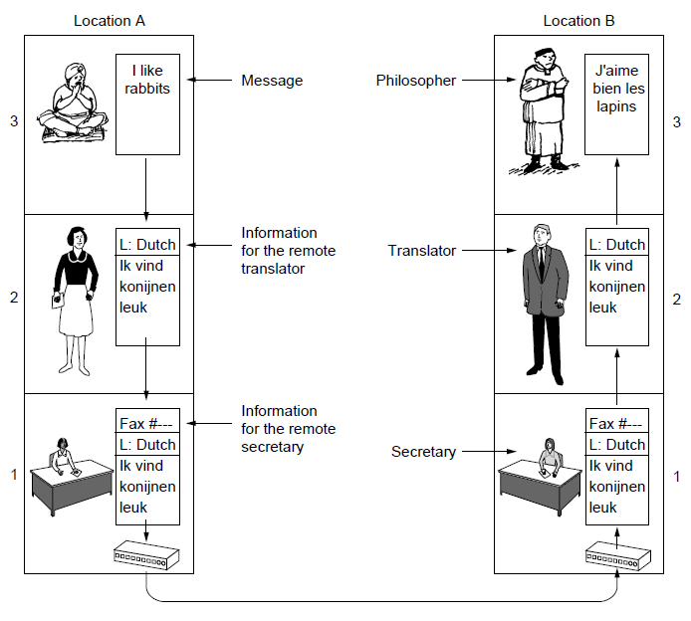
Protocol Layers (2)
Example: the philosopher-translator-secretary architecture
Each protocol at different layers serves a different purpose

Slide 17
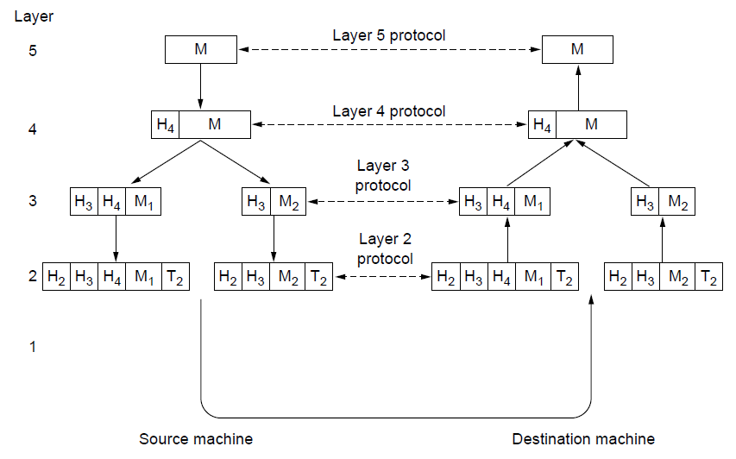
Protocol Layers (3)
Each lower layer adds its own header (with control inform-ation) to the message to transmit and removes it on receive
Layers may also split and join messages, etc.

Slide 18
Design Issues for the Layers
Each layer solves a particular problem but must include mechanisms to address a set of recurring design issues
Issue | Example mechanisms at different layers
Reliability despite failures | Codes for error detection/correction (§3.2, 3.3) Routing around failures (§5.2)
Network growth and evolution | Addressing (§5.6) and naming (§7.1) Protocol layering (§1.3)
Allocation of resources like bandwidth | Multiple access (§4.2) Congestion control (§5.3, 6.3)
Security against various threats | Confidentiality of messages (§8.2, 8.6) Authentication of communicating parties (§8.7)
Notes:
The point is that there are some issues that are not wholly the responsibility of any one layer, and they crop up again and again in the text. For example, reliability is often considered a key function of the transport layer (i.e., making transport reliable) yet reliability mechanisms also appear in other layers (error codes in the link layer, routing around failures in the network layer, and replication at the application layer).

Slide 19
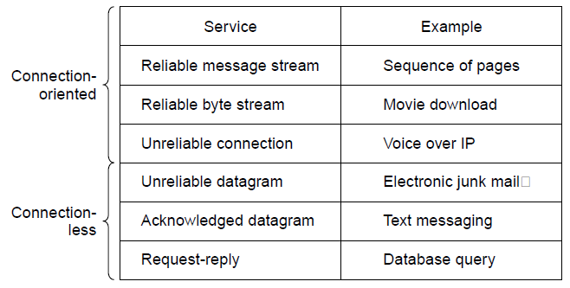
Connection-Oriented vs. Connectionless
Service provided by a layer may be kinds of either:
Connection-oriented, must be set up for ongoing use (and torn down after use), e.g., phone call
Connectionless, messages are handled separately, e.g., postal delivery
Notes:
TCP provides a reliable bytestream service at the Transport layer, IP provides unreliable datagram service at the Network layer.
More examples: RTP (used to carry VoIP data) provides unreliable connection service; 802.11 (WiFi) provides acknowledged datagram service; Ethernet provides unreliable datagram service.

Slide 20
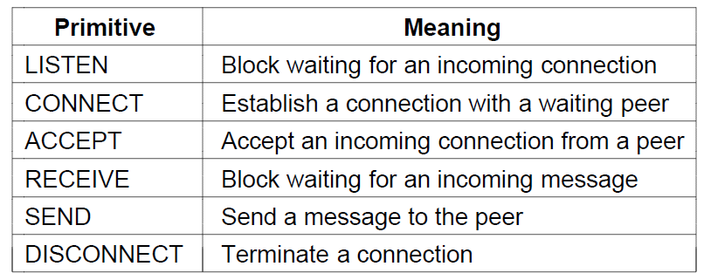
Service Primitives (1)
A service is provided to the layer above as primitives
Hypothetical example of service primitives that may provide a reliable byte stream (connection-oriented) service:

Slide 21
Service Primitives (2)
Hypothetical example of how these primitives may be used for a client-server interaction
Client
Server
LISTEN (0)
CONNECT (1)
Connect request
ACCEPT
(2)
Accept response
RECEIVE
SEND
Request for data
(3)
RECEIVE
SEND (4)
Reply
DISCONNECT (5)
Disconnect
DISCONNECT (6)
Disconnect
Notes:
The primitives are called at the client and server by the higher layer using the service. The layer implements the primitives by sending messages using the services of the lower layer; these messages are assumed to be reliable for simplicity and the lower layer service is not otherwise described.
This is similar to the way that simple Web browsers and Web servers work today.

Slide 22
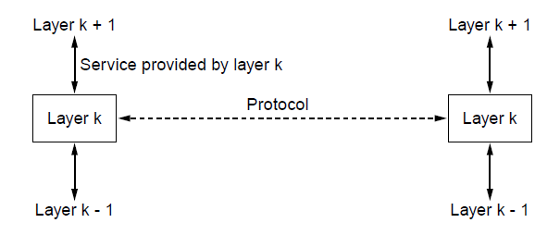
Relationship of Services to Protocols
Recap:
A layer provides a service to the one above [vertical]
A layer talks to its peer using a protocol [horizontal]

Slide 23
Reference Models
Reference models describe the layers in a network architecture
OSI reference model »
TCP/IP reference model »
Model used for this text »
Critique of OSI and TCP/IP »

Slide 24
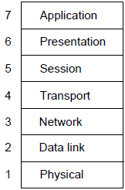
OSI Reference Model
A principled, international standard, seven layer model to connect different systems
– Provides functions needed by users
– Converts different representations
– Manages task dialogs
– Provides end-to-end delivery
– Sends packets over multiple links
– Sends frames of information
– Sends bits as signals

Slide 25
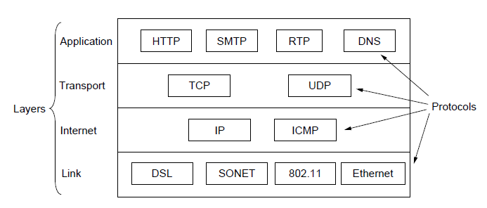
TCP/IP Reference Model
A four layer model derived from experimentation; omits some OSI layers and uses the IP as the network layer.
IP is the “narrow waist” of the Internet
Protocols are shown in their respective layers
Notes:
The comment about the narrow waist refers to the fact that the network layer of the Internet is IP (Internet Protocol) such that the network layer is called the “Internet” layer. The significance is that all Internet devices speak IP, which provides a point of interoperability that enables innovation both above (new applications and transports) and below (new link technologies).

Slide 26
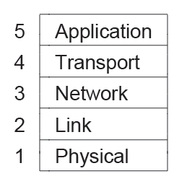
Model Used in this Book
It is based on the TCP/IP model but we call out the physical layer and look beyond Internet protocols.

Slide 27
Critique of OSI & TCP/IP
OSI:
Very influential model with clear concepts
Models, protocols and adoption all bogged down by politics and complexity
TCP/IP:
Very successful protocols that worked well and thrived
Weak model derived after the fact from protocols

Slide 28
Example Networks
The Internet »
3G mobile phone networks »
Wireless LANs »
RFID and sensor networks »

Slide 29
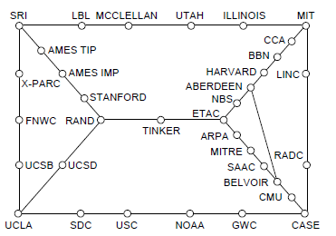
Internet (1)
Before the Internet was the ARPANET, a decentralized, packet-switched network based on Baran’s ideas.
Nodes are IMPs, or early routers, linked to hosts
56 kbps links
ARPANET topology in Sept 1972.
Notes:
Decentralized or fully distributed is a contrast to the hierarchical telephone network that came beforehand. Unlike the telephone network, blowing up a single important node will not break the network or large portions of it.

Slide 30
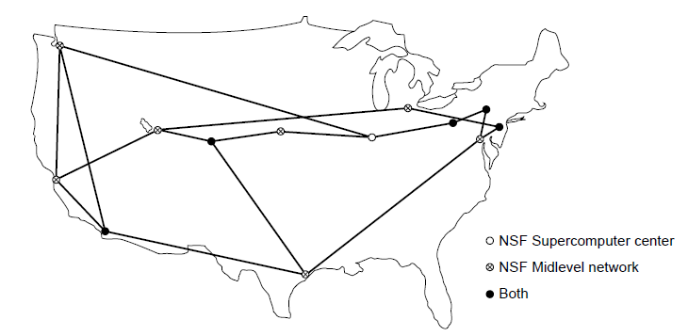
Internet (2)
The early Internet used NSFNET (1985-1995) as its backbone; universities connected to get on the Internet
T1 links (1.5 Mbps)
NSFNET topology in 1988
Notes:
NSFNET was an academic research network growing out of CSNET that was created so that universities without DoD contracts could participate. It was initially connected to the ARPANET by gateways, and later took over the central role as the “backbone of the Internet”, i.e., the network through which packets passed on their way between parties connected to different parts of the Internet.

Slide 31
Internet (3)
The modern Internet is more complex:
ISP networks serve as the Internet backbone
ISPs connect or peer to exchange traffic at IXPs
Within each network routers switch packets
Between networks, traffic exchange is set by business agreements
Customers connect at the edge by many means
Cable, DSL, Fiber-to-the-Home, 3G/4G wireless, dialup
Data centers concentrate many servers (“the cloud”)
Most traffic is content from data centers (esp. video)
The architecture continues to evolve
Notes:
ISP = Internet Service Provicer, IXP = Internet eXchange Point

Slide 32
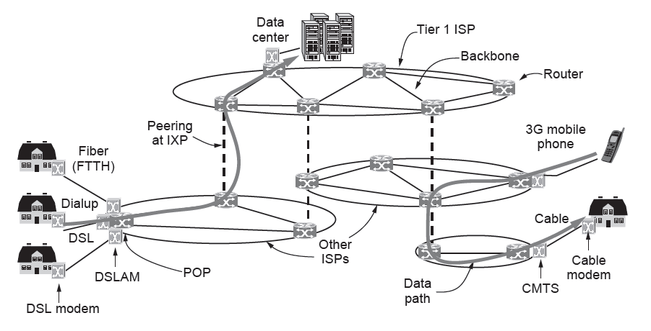
Internet (4)
Architecture of the Internet

Slide 33
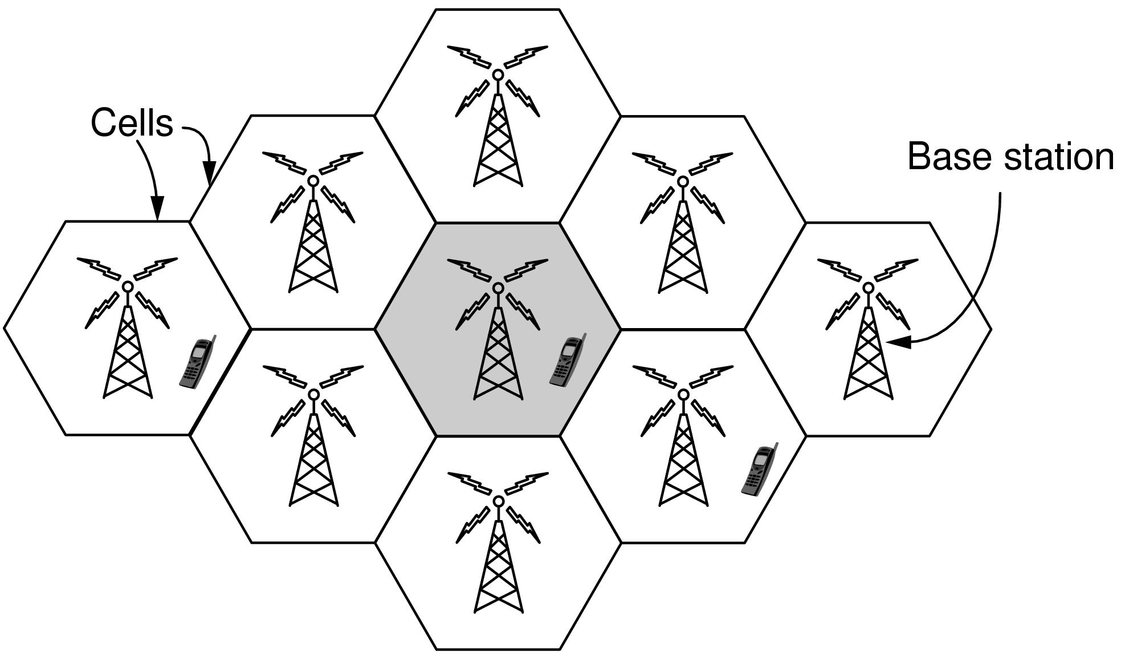
3G Mobile Phone Networks (1)
3G network is based on spatial cells; each cell provides wireless service to mobiles within it via a base station

Slide 34
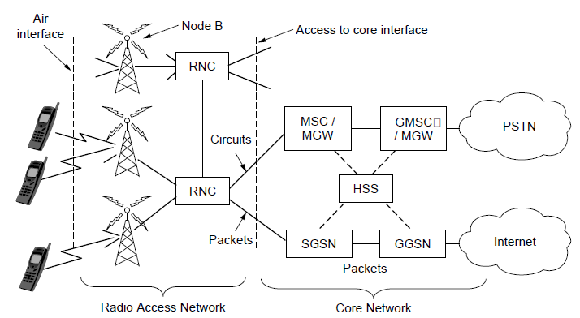
3G Mobile Phone Networks (2)
Base stations connect to the core network to find other mobiles and send data to the phone network and Internet

Slide 35
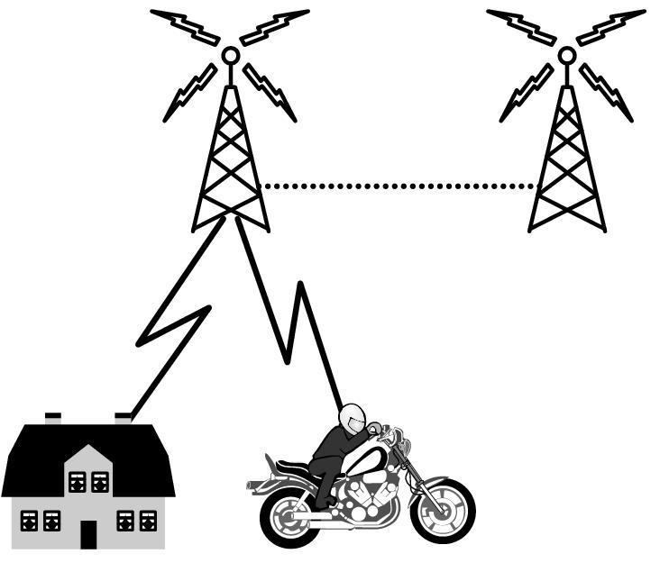
3G Mobile Phone Networks (3)
As mobiles move, base stations hand them off from one cell to the next, and the network tracks their location
Handover

Slide 36
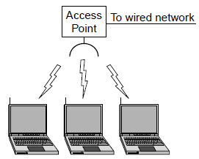
Wireless LANs (1)
In 802.11, clients communicate via an AP (Access Point) that is wired to the rest of the network.

Slide 37
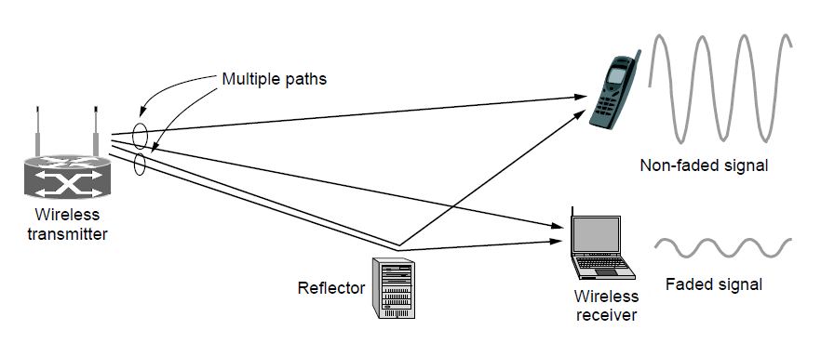
Wireless LANs (2)
Signals in the 2.4GHz ISM band vary in strength due to many effects, such as multipath fading due to reflections
requires complex transmission schemes, e.g., OFDM

Slide 38
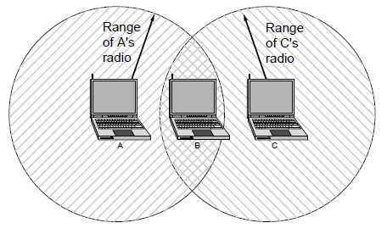
Wireless LANs (3)
Radio broadcasts interfere with each other, and radio ranges may incompletely overlap
CSMA (Carrier Sense Multiple Access) designs are used
Notes:
Both broadcast and different ranges are complications that do not exist for point-to-point wired links.

Slide 39
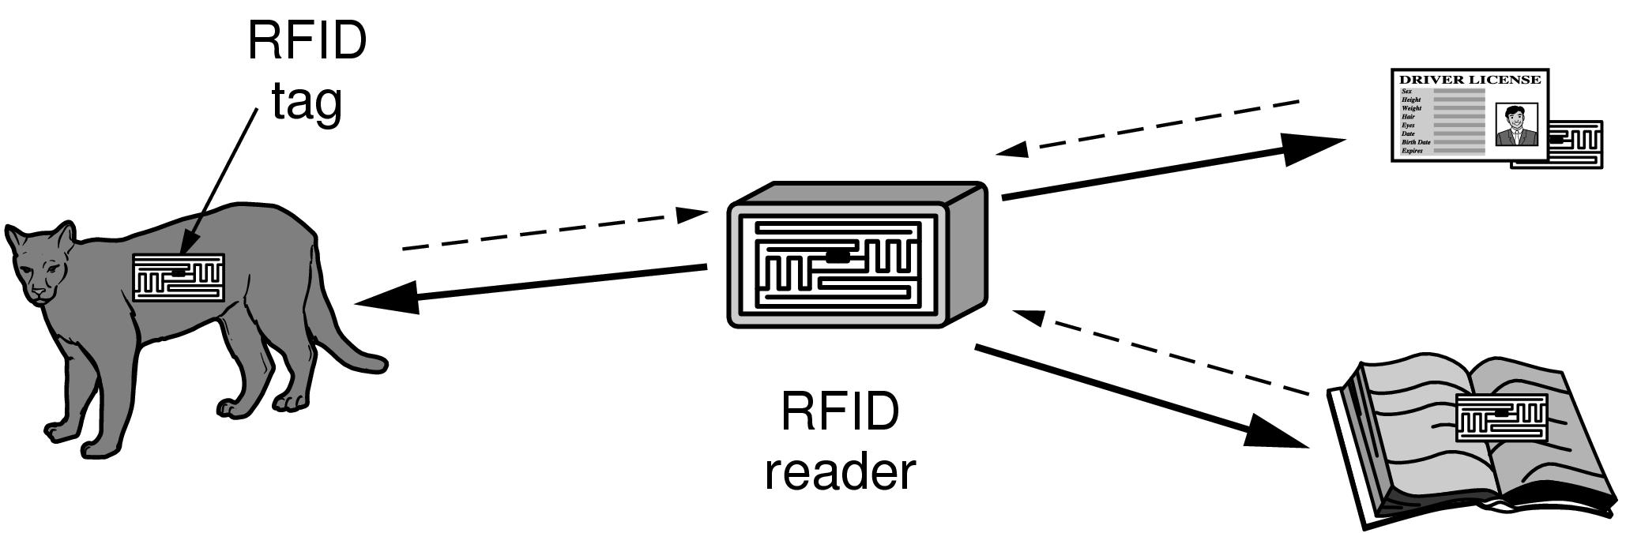
RFID and Sensor Networks (1)
Passive UHF RFID networks everyday objects:
Tags (stickers with not even a battery) are placed on objects
Readers send signals that the tags reflect to communicate

Slide 40
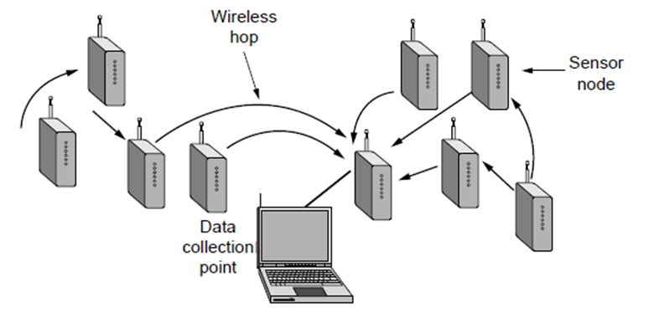
RFID and Sensor Networks (2)
Sensor networks spread small devices over an area:
Devices send sensed data to collector via wireless hops

Slide 41
Network Standardization
Standards define what is needed for interoperability
Some of the many standards bodies:
Body | Area | Examples
ITU | Telecommunications | G.992, ADSL H.264, MPEG4
IEEE | Communications | 802.3, Ethernet 802.11, WiFi
IETF | Internet | RFC 2616, HTTP/1.1 RFC 1034/1035, DNS
W3C | Web | HTML5 standard CSS standard

Slide 42
Metric Units
The main prefixes we use:
Use powers of 10 for rates, powers of 2 for storage
E.g., 1 Mbps = 1,000,000 bps, 1 KB = 1024 bytes
“B” is for bytes, “b” is for bits
Prefix | Exp. | prefix | exp.
K(ilo) | 10³ | m(illi) | 10⁻³
M(ega) | 10⁶ | μ(micro) | 10⁻⁶
G(iga) | 10⁹ | n(ano) | 10⁻⁹
Notes:
You’ll also see kbps and KB. The lowercase k in kbps is for historical reasons.

Slide 43
End
Chapter 1

